Slide 1
Queue Overview

Slide 2
Queue Overview
In this lecture we will get an overview of what a Queue is.
in the next lecture we will implement our own Queue class.

Slide 3
Queue
A queue is an ordered collection of items where the addition of new items happens at one end, called the “rear,” and the removal of existing items occurs at the other end, commonly called the “front.”
As an element enters the queue it starts at the rear and makes its way toward the front, waiting until that time when it is the next element to be removed.

Slide 4
Queue
The most recently added item in the queue must wait at the end of the collection.
The item that has been in the collection the longest is at the front.
This ordering principle is sometimes called FIFO, first-in first-out.
It is also known as “first-come first-served.”

Slide 5
Queue
The simplest example of a queue is the typical line that we all participate in from time to time.
We wait in a line for a movie, we wait in the check-out line at a grocery store, and we wait in the cafeteria line.
The first person in that line is also the first person to get serviced/helped.

Slide 6
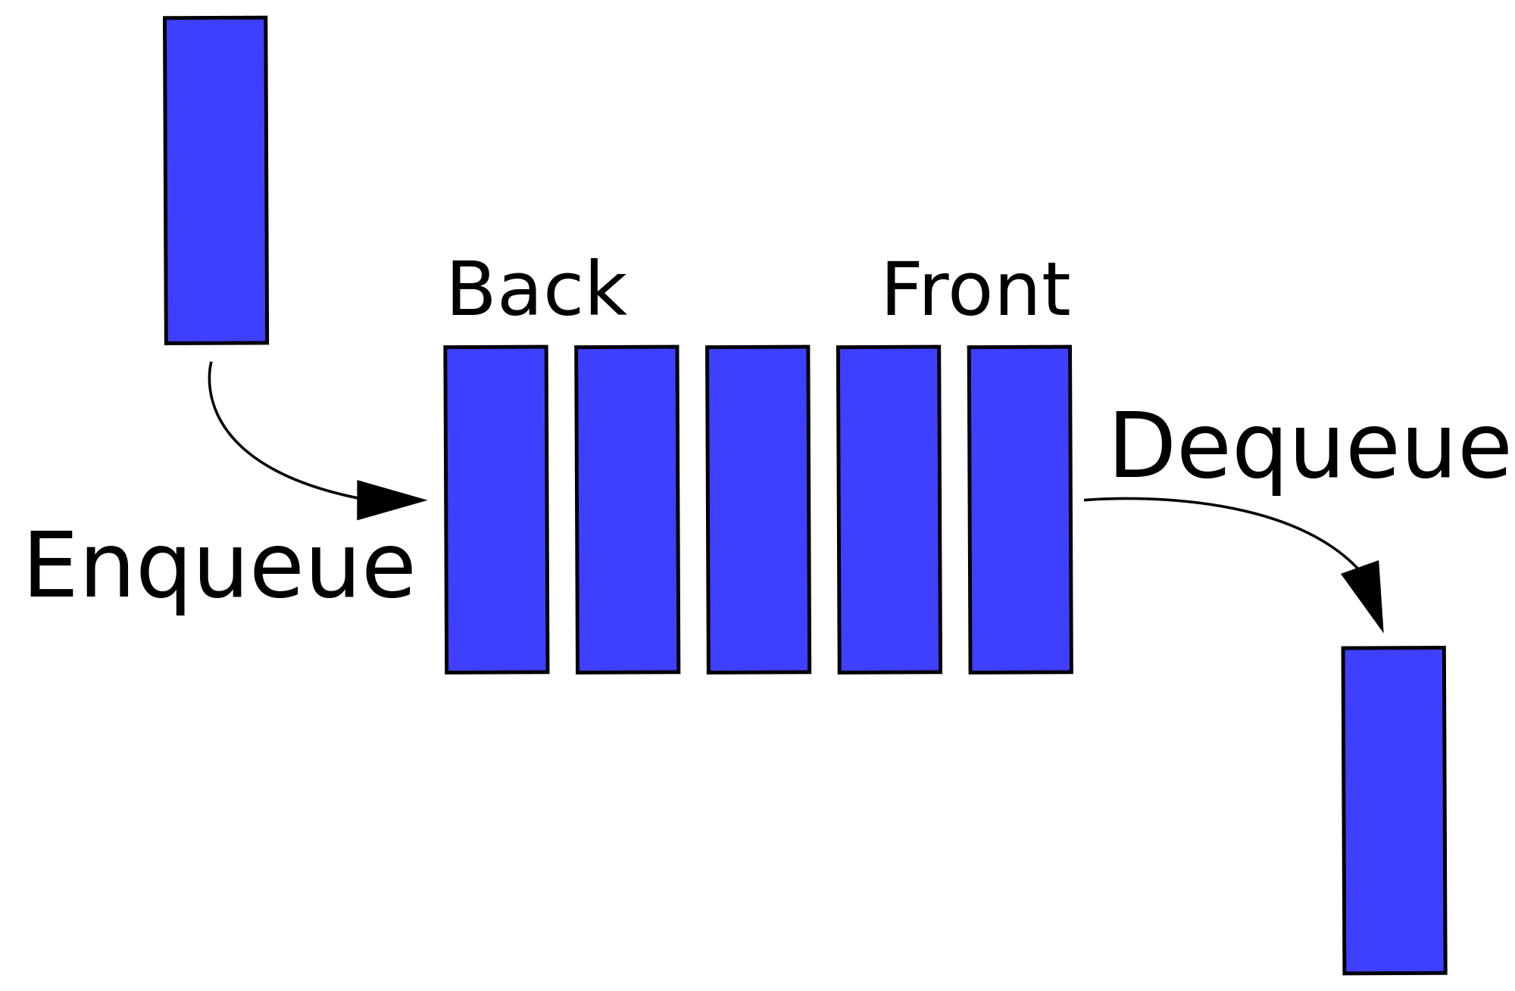
Queue

Slide 7
Queue
Note how we have two terms here, Enqueue and Dequeue.
The enqueue term describes when we add a new item to the rear of the queue.
The dequeue term describes removing the front item from the queue.

Slide 8
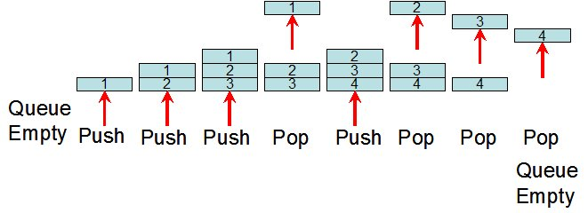
Queue

Slide 9
Queue
You should now have a basic understanding of Queues and the FIFO principal for them.
In the next lecture we will implement our own Queue class!

